Slide 1
Chapter 2 Forces(continue..)
Applied Mechanics
Moments, Couples, and Force Couple Systems

Slide 2
Introduction
Ability of force to produce rotational motion.
The rotational effect of force.
Also known as torque.
In magnitude, torque = force X moment arm = F X r
    (moment arm :perpendicular distance between the line of action of force and the axis of rotation(centre of rotation))
In vector form = r X F

Slide 3
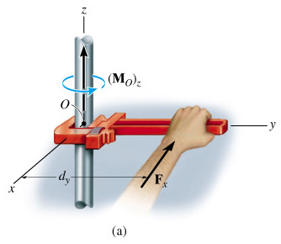
Introduction to Moments
The tendency of a force to rotate a rigid body about any defined axis is called the Moment of the force about the axis

Slide 4
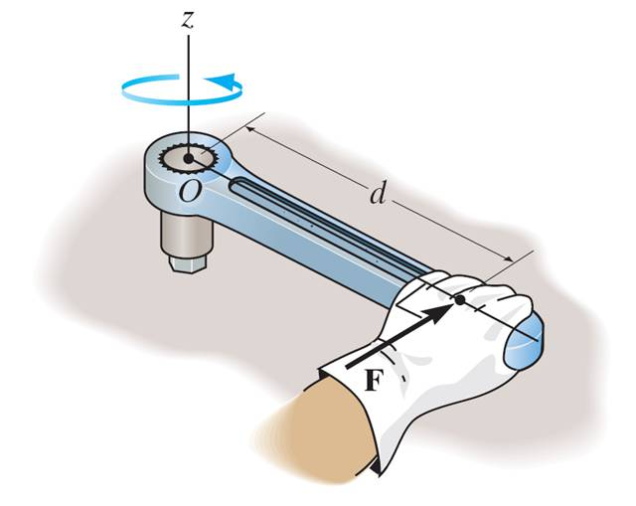
MOMENT OF A FORCE
M
The moment, M, of a force about a point provides a measure of the tendency for rotation (sometimes called a torque).
M = F * d
Notes:
Statics:The Next Generation (2nd Ed.) Mehta, Danielson & Berg Lecture Notes for Sections 4.1-4.4

Slide 5
Moment caused by a Force
The Moment of Force (F) about an axis through Point (A), is the product of the magnitude of the force and the perpendicular distance between Point (A) and the line of action of Force (F)
  M_{A} = Fd

Slide 6
Units of a Moment
The units of a Moment are:
  N·m in the SI system

Slide 7

Moment of a Force About a Point
The moment M of a force F about a point P is in magnitude equal to F times the perpendicular distance from P to the line of action of force F.
If r is the position vector from p to the initial point Q of F
then,
moment = force x perpendicular distance =

Slide 8
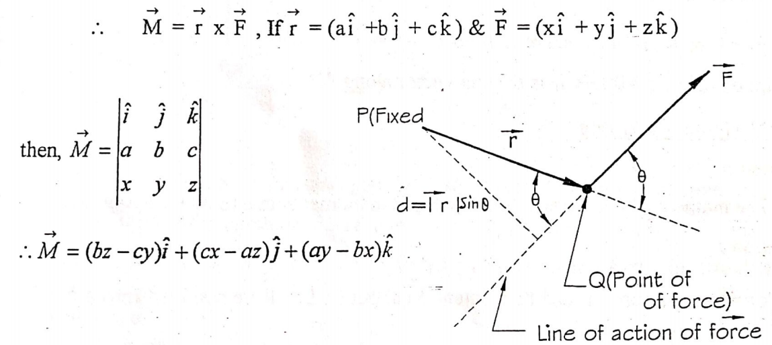

Slide 9
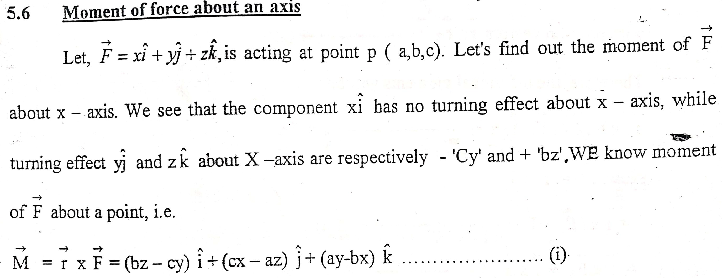
Moment of force about an axis

Slide 10
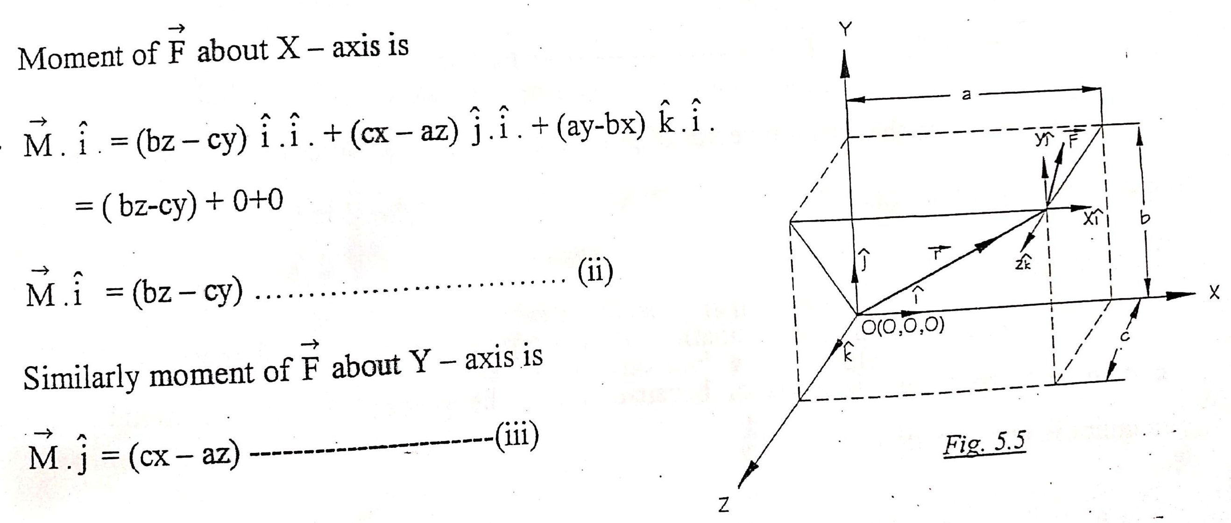

Slide 11
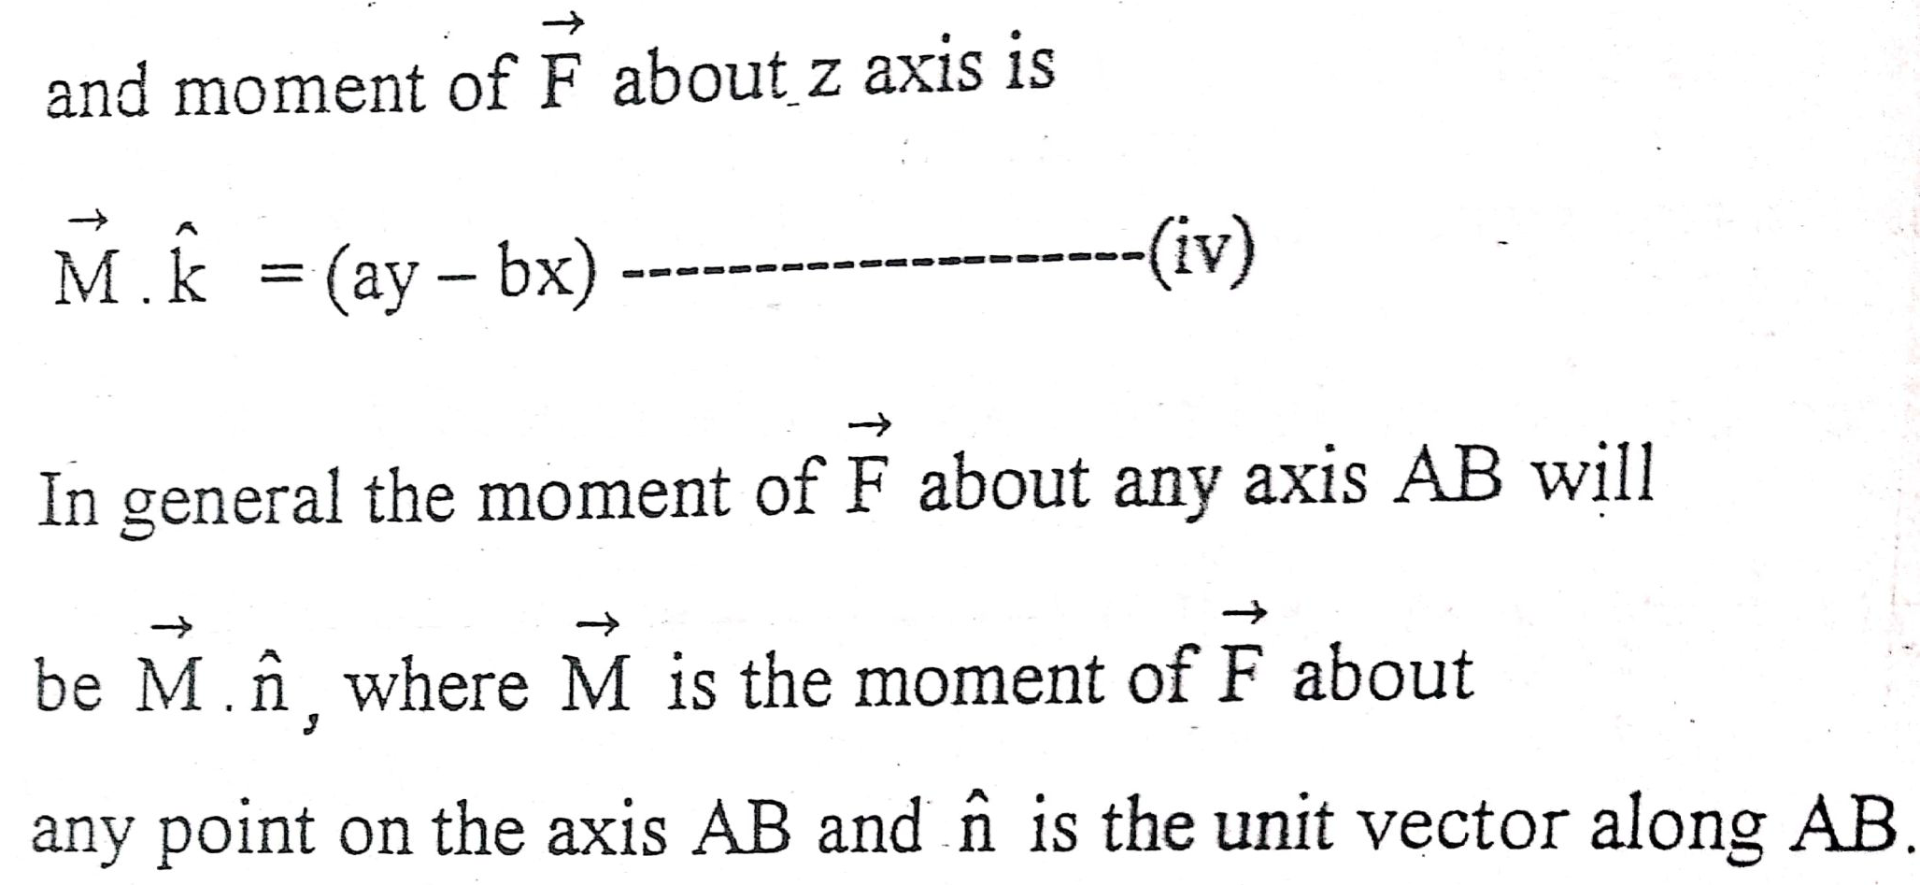

Slide 12
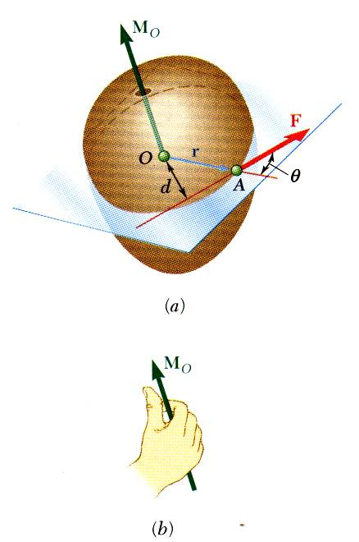
Moment of a Force About a Point

Slide 13
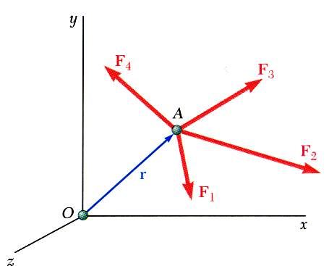
Varignon’s Theorem
The moment of force equals the sum of the moments due to its components.
The moment about a given point O of the resultant of several concurrent forces is equal to the sum of the moments of the various moments about the same point O.
Varignon's Theorem makes it possible to replace the direct determination of the moment of a force F by the moments of two or more component forces of F.

Slide 14
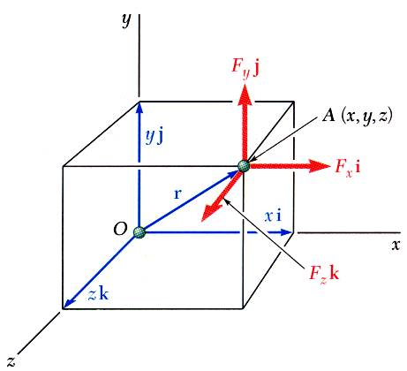
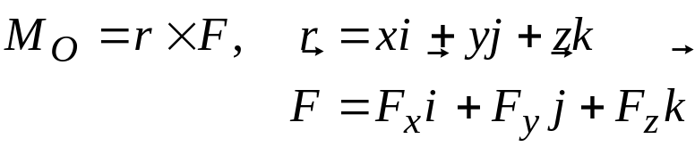
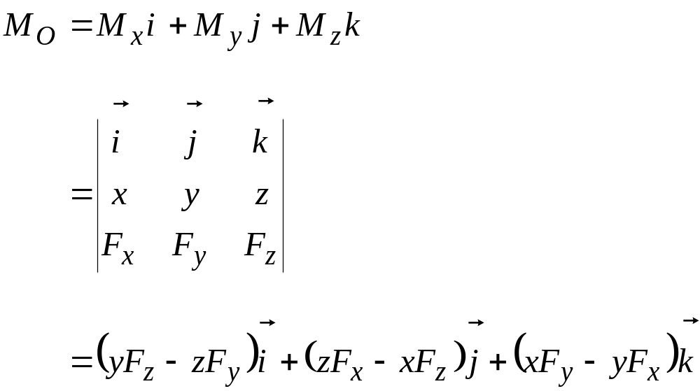
Rectangular Components of the Moment of a Force about a point
The moment of F about O,

Slide 15
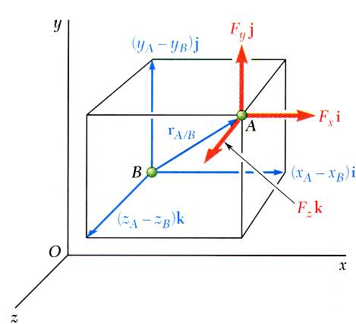
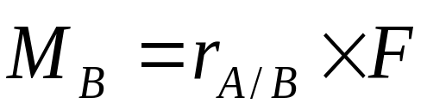
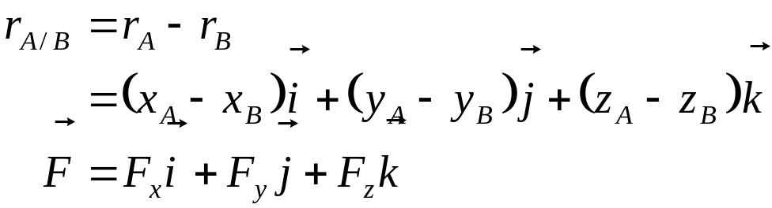
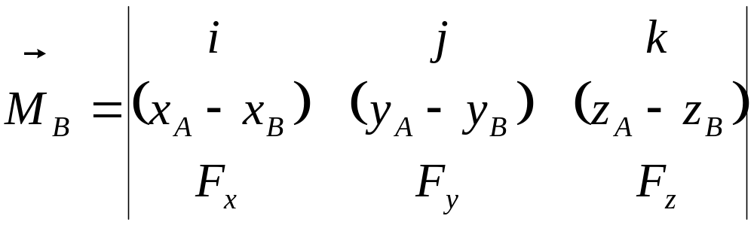
The moment of F about B,

Slide 16
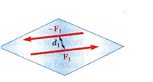
Force Couples
A Couple is defined as two Forces having the same magnitude, parallel lines of action, and opposite sense.

Slide 17
Unit of couple
Unit of couple is :
Nm

Slide 18
Characteristics of Couples
The sum of the forces in each direction is zero, so a couple does not affect the sum of forces equations
A force couple will however tend to rotate the body it is acting on .
Translation effect in couple is zero.
Rotational effect is only act in couple and it remains constant.
A couple cannot be balanced by single force, but can be balanced only by a couple ,but of opposite sense.

Slide 19
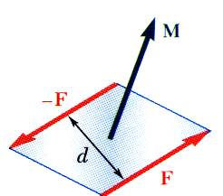
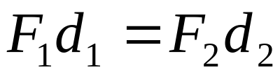
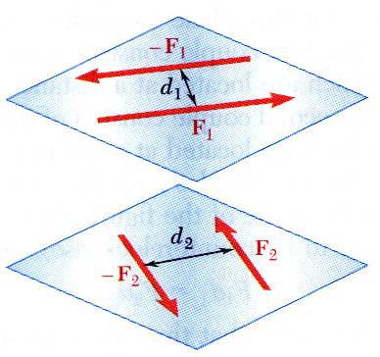
Characteristics of Couples
Two couples will have equal moments if
The two couples lie in parallel planes,
The two couples have the tendency to cause rotation in the same direction.

Slide 20

      Anticlockwise couple:
    A couple, whose tendency is to rotate the body, on which its acts , in anticlockwise direction.

Slide 21
Clockwise couple:
  A couple, whose tendency is to rotate the body on which it acts, in clockwise direction.

Slide 22
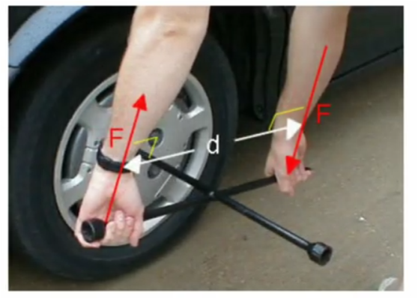
Real life application of couple

Slide 23
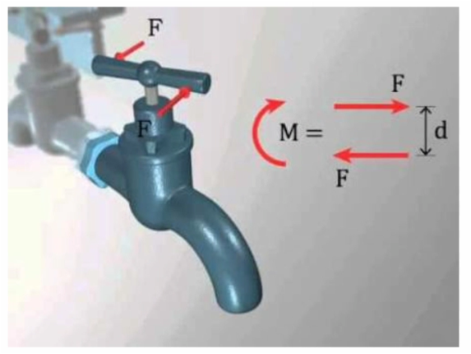

Slide 24
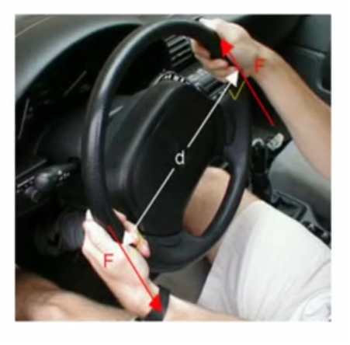

Slide 25
Couples are Free Vectors
The point of action of a Couple does not matter.
The plane that the Couple is acting in does not matter.
All that matters is the orientation of the plane the Couple is acting in
Therefore, a Force Couple is said to be a Free Vector and can be applied at any point on the body it is acting.

Slide 26
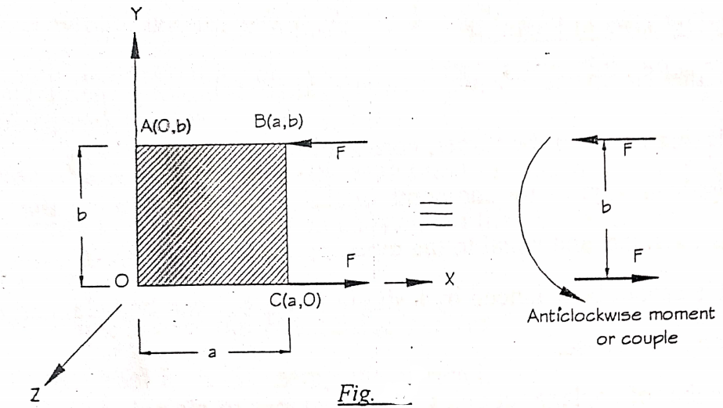

Slide 27
Consider a rectangular plate OABC lies in xy plane.
Two equal and opposite force of magnitude F are applied as in fig.
Distance between parallel forces is “b”.
It forms a couple having direction towards positive Z axis.
Then , Couple (c)= b F k

Slide 28
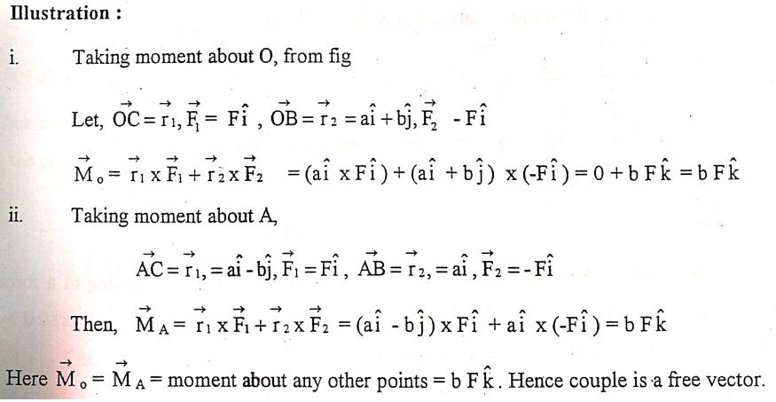

Slide 29
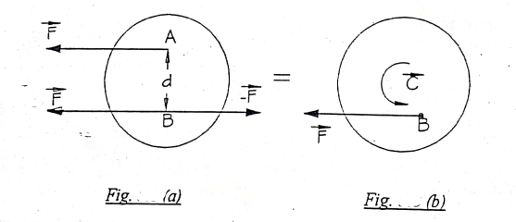
Resolution of force into a force and a couple

Slide 30
Resultant of system of forces
Resultant of system of forces can be obtained as below:
a.Wrench
b.Simplest resultant of a general force system
c.Simplest resultant of a coplanar force system
d.Simplest resultant of a parallel forces system in space.

Slide 31
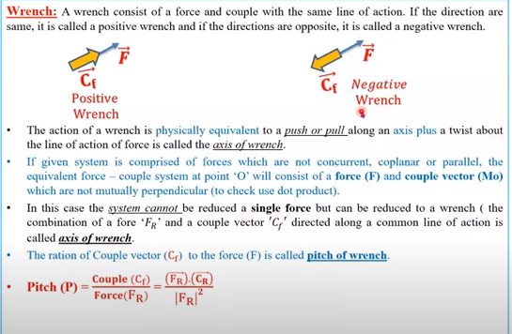
a.Wrench

Slide 33
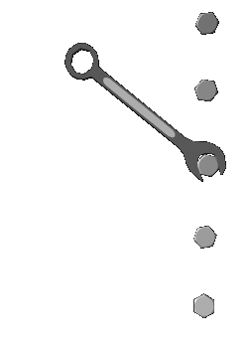

Wrench Examples

Slide 34
Formation of wrench:
See in your note.

Slide 35
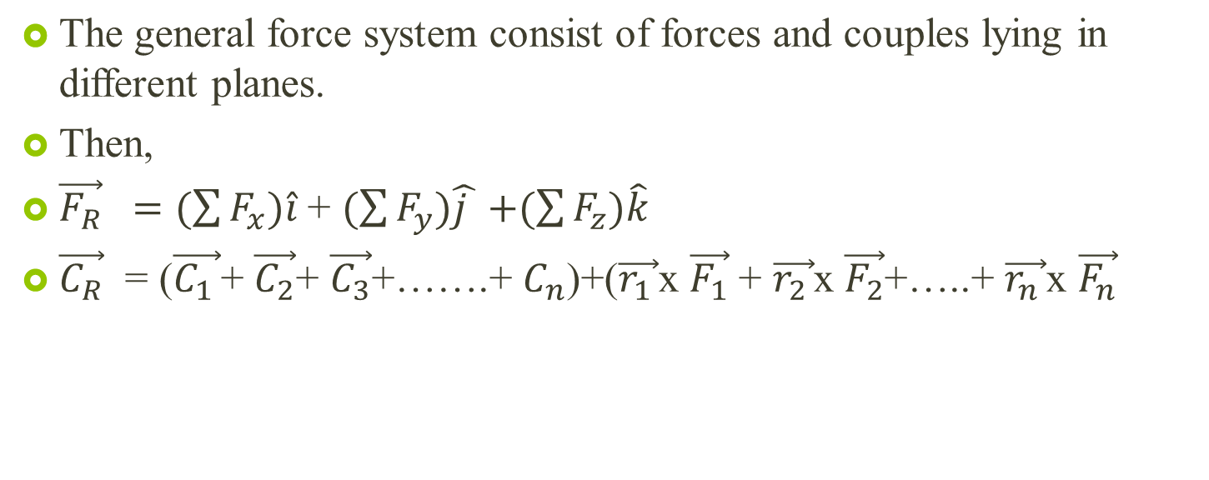
b. Simplest resultant of a general force system

Slide 36
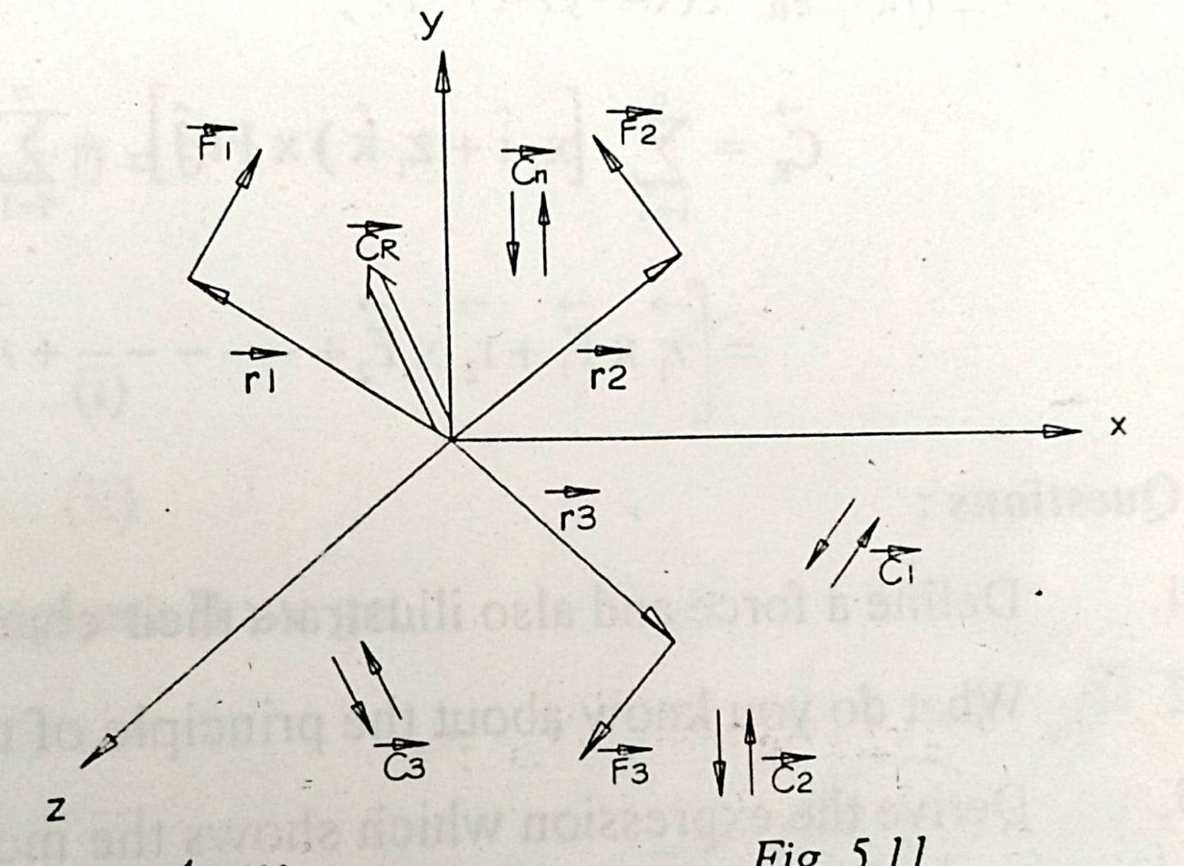
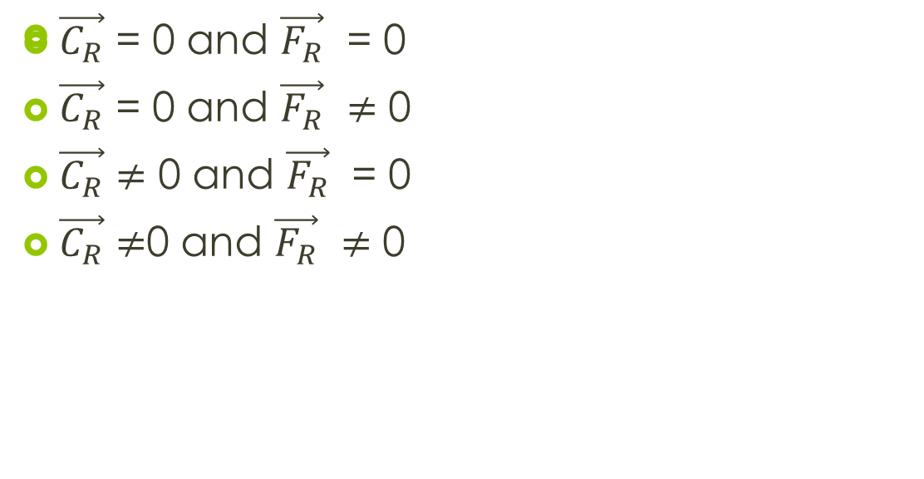
These may be further combined into a wrench. Four possible cases may arise.

Slide 37
c. Simplest resultant of a coplanar force system
Let the forces and couple are in zx plane as shown in fig.
The force can be transferred to a common point A, such that additional couples will be formed.

Slide 38
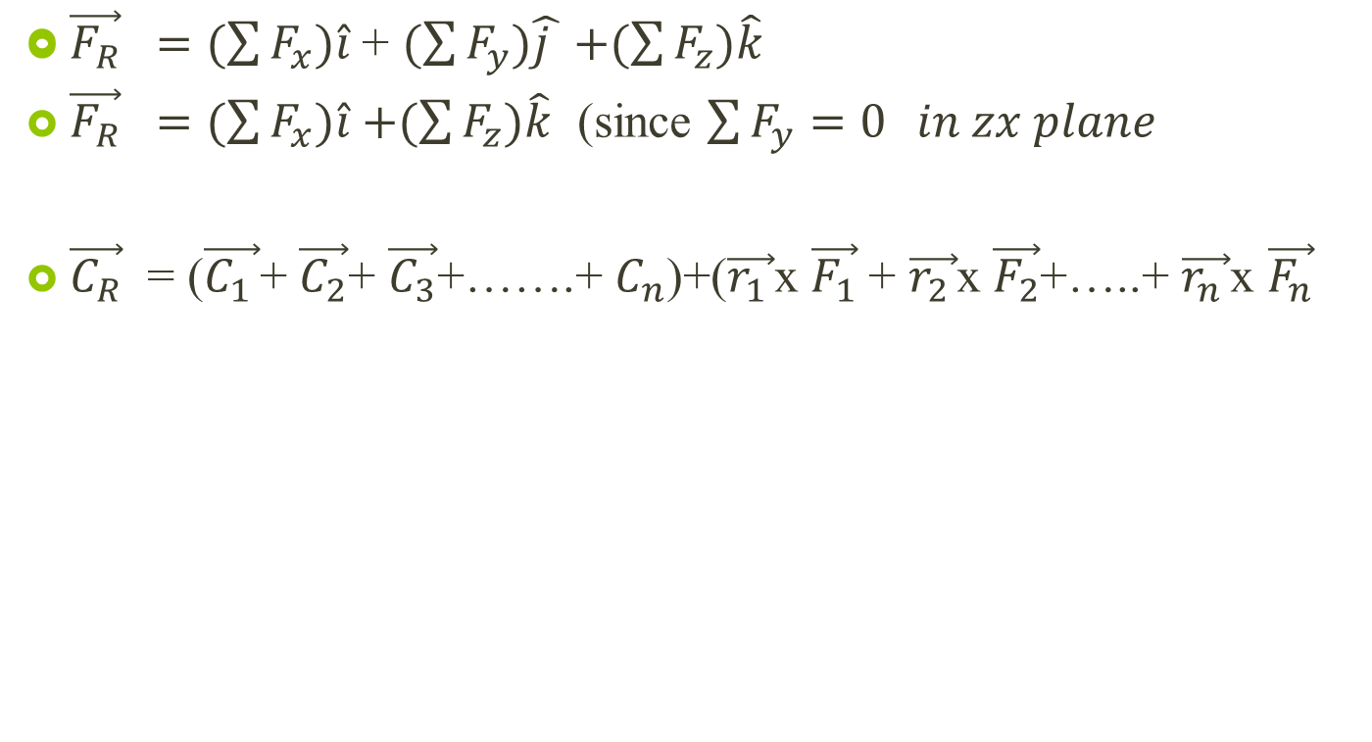
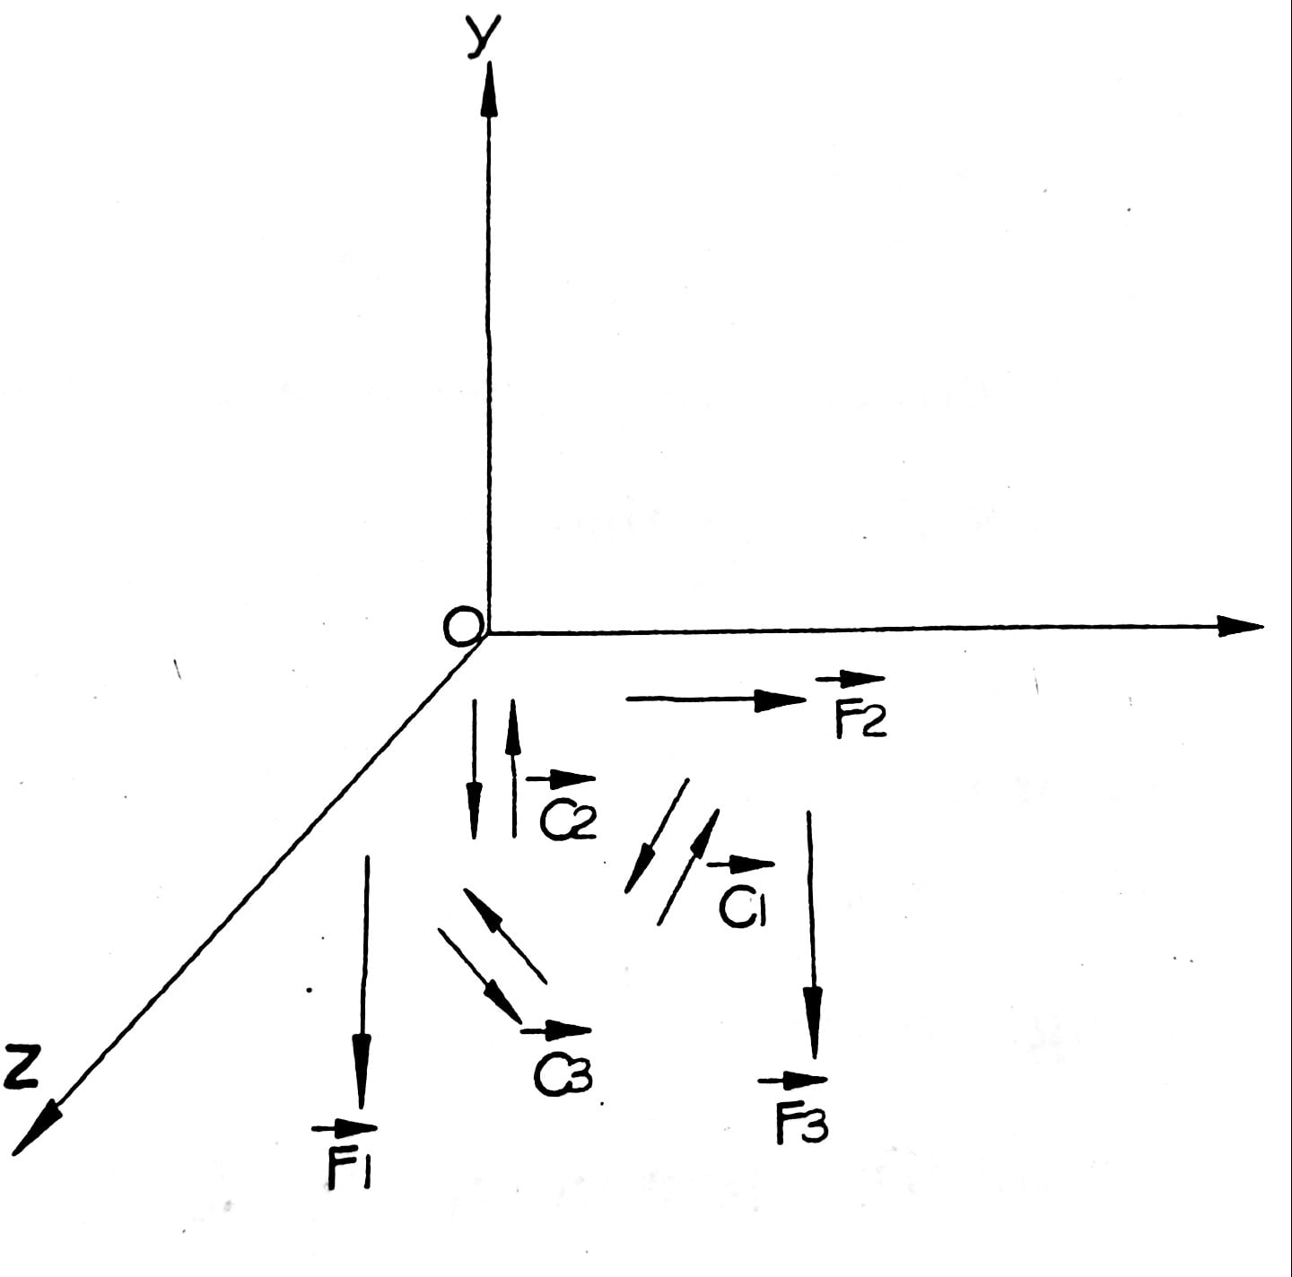

Slide 39
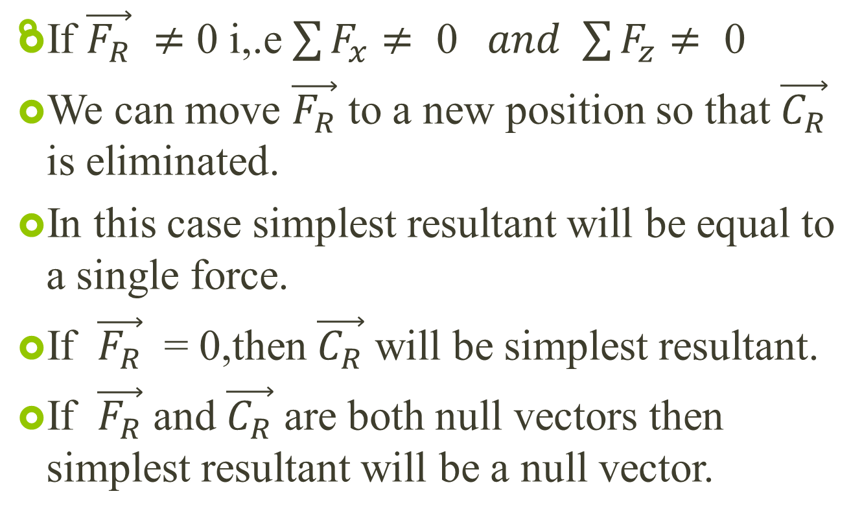

Slide 40
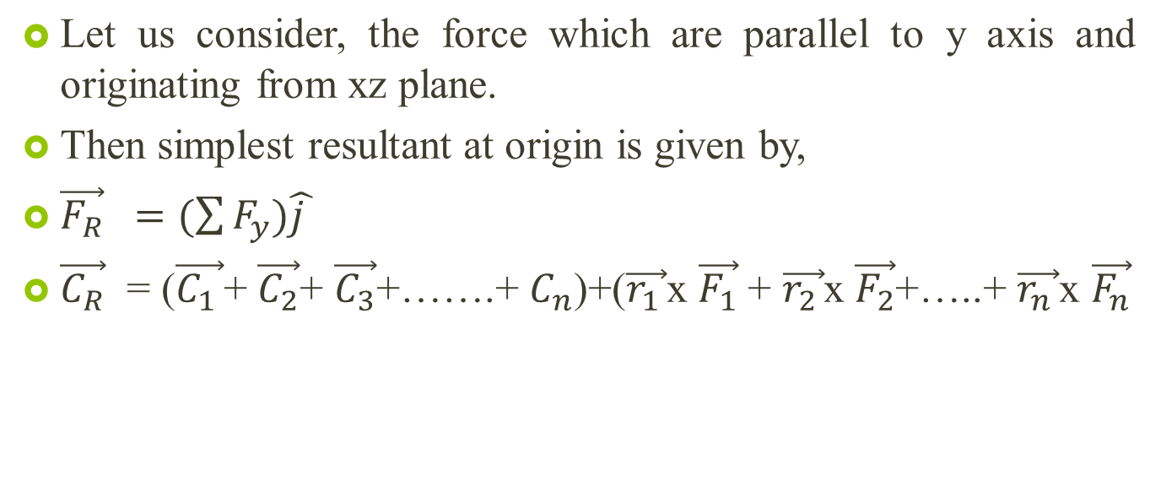
d. Simplest resultant of a parallel force system in space

